Slide 1
Mansib Ahmed Lab 10 Report
Email: sma6629@psu.edu
Course: CMPSC 497
Date: 11/14/2023

Slide 2
Table of Content
Slide 3: Objective
Slide 4: Background & Context
Slide 5: Dataset Overview
Slide 6: Part 1 (Classify images from each class with unmodified alexnet)
Slide 7-13: Part 2
Slide 14-17: Part 3
Slide 18: Conclusion
Slide 19-20: Appendix (Matlab code)

Slide 3
Objective
To conduct a parametric study of utilizing deep learning to detect defects in manufactured bottles with lids.

Slide 4
Background & Context
The motivation for doing this project is to get a hands-on experience in training a deep learning neural network using transfer learning. A potential application of this project could be as a bottle lid defection system used by bottle manufacturing companies. This system would provide an efficient and automated way of discarding defective products.

Slide 5
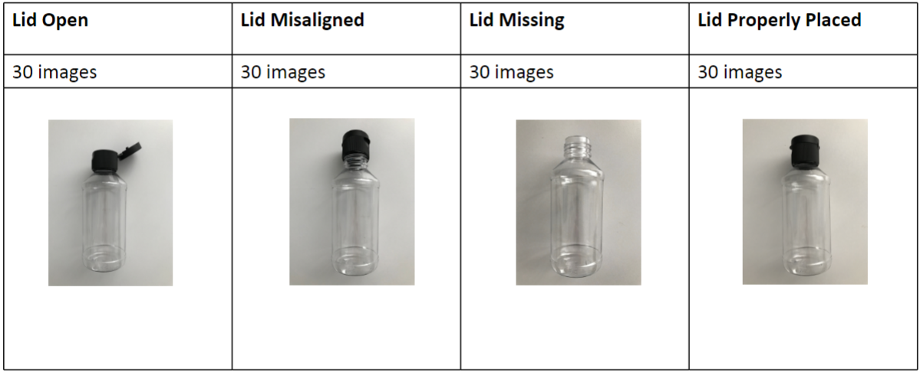
Dataset Overview

Slide 6
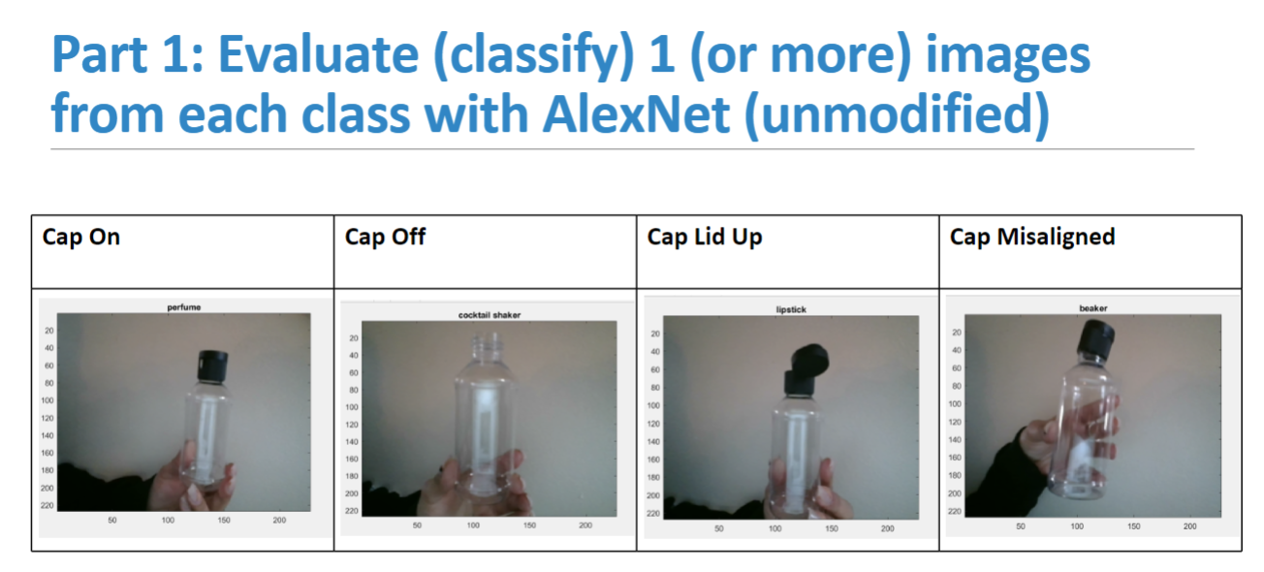

Slide 7
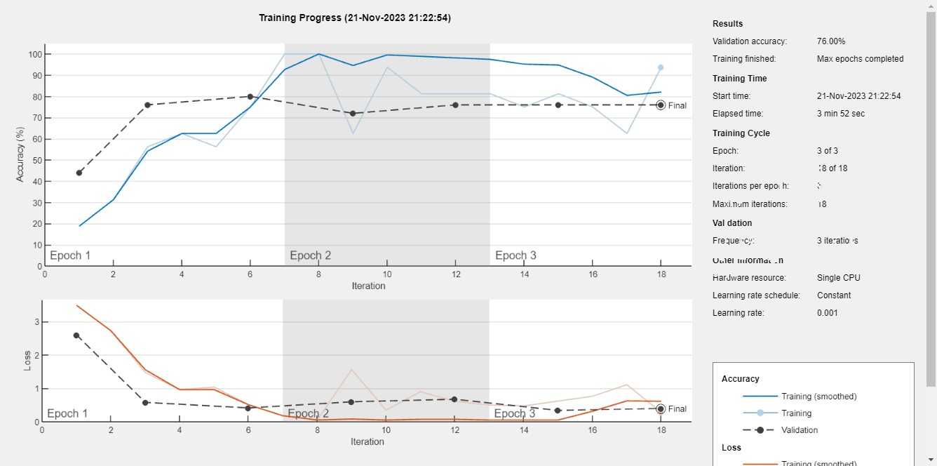
Part 2: Study 1
With 3 Epochs
Accuracy = 76%

Slide 8
Part 2: Study 1
Confusion Chart for 3 epochs

Slide 9
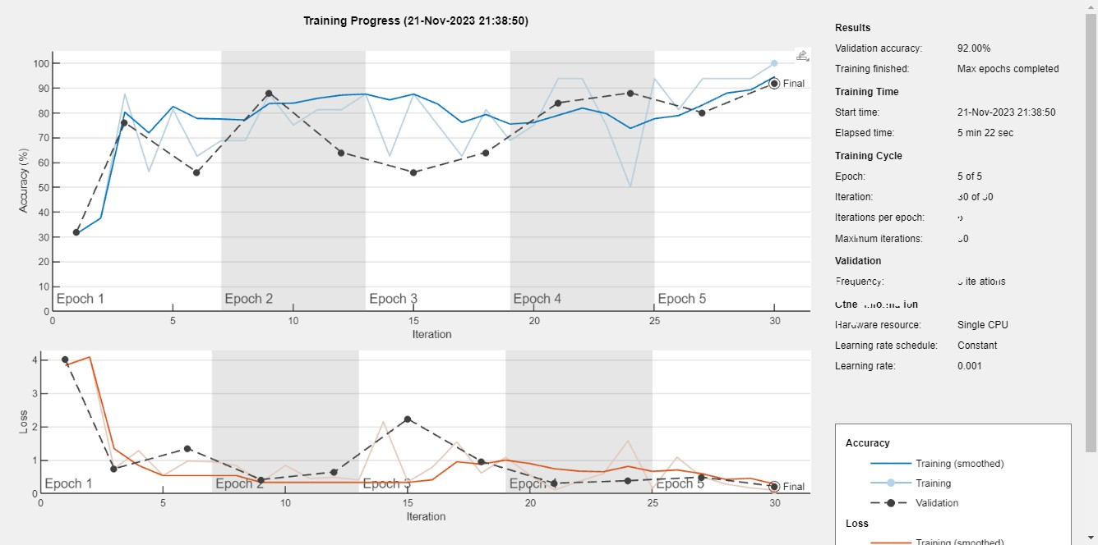
Part 2: Study 1
With 5 Epochs
Accuracy = 92%

Slide 10
Part 2: Study 1
Confusion chart for 5 epochs

Slide 11
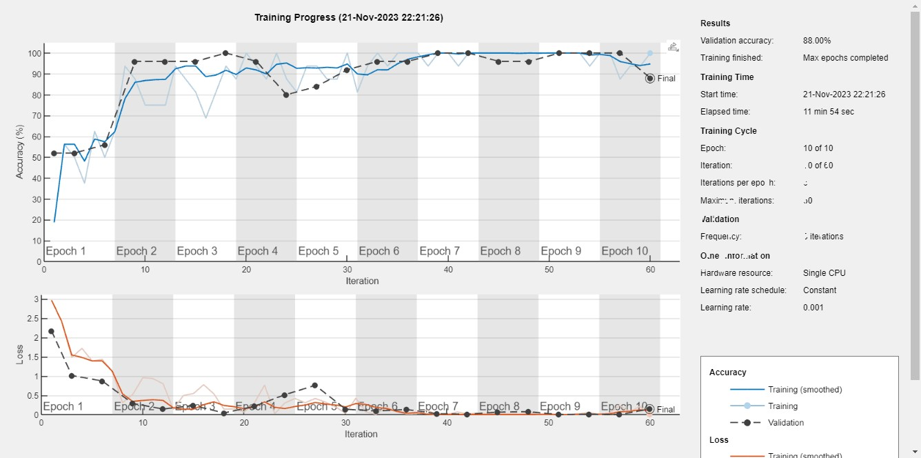
Part 2: Study 1
With 10 Epochs
Accuracy = 88%

Slide 12
Part 2: Study 1
Confusion chart for 10 epochs

Slide 13
Effect of Number of Epochs on Accuracy
Part 2: Study 1
Min batch size = 16
learning rate = 0.001
Number of classes = 4
Classes = cap on, cap off, lid up, cap misaligned
Number of images in each class = 30
Computer used for training: Windows 11, core i5, 12GB RAM
Name train time # of epochs accuracy
bottleNet1 3min 52 secs 3 0.76
bottleNet2 5min 22 secs 5 0.92
bottleNet3 11min 54 secs 10 0.88

Slide 14
Part 3: Study 1 (Successful test cases)
Image (227 x 227) | Class name | bottle_net2 (#epochs=5; minbatchsize=16; learningrate=0.001; accuracy=0.92)
 | Lid missing | Lid missing (successful)
 | Lid open | Lid open (successful)

Slide 15
Part 3: Study 1 (Successful test cases)
Image (227 x 227) | Class name | bottle_net2 (#epochs=5; minbatchsize=16; learningrate=0.001; accuracy=0.92)
 | Lid properly placed | Lid properly placed (successful)
 | Lid | Lid open (successful)

Slide 16
Part 3: Study 2 (Failed test cases)
Image (227 x 227) | Class name | bottle_net2 (#epochs=5; minbatchsize=16; learningrate=0.001; accuracy=0.92)
 | Lid open | Lid properly placed (failed) Cap was slightly open. It couldn’t differentiate between slightly open and properly placed. This could be due to a lack of data surrounding this test case.
 | Lid properly placed | Lid open (failed) Cap was properly placed and the lid was closed. This likely failed because the image shows the bottle from the back and the model was mostly trained from the front.

Slide 17
Part 3: Study 2 (Failed test cases)
Image (227 x 227) | Class name | bottle_net2 (#epochs=5; minbatchsize=16; learningrate=0.001; accuracy=0.92)
 | Lid misaligned | Lid open (failed) This image likely failed because it was unable to differentiate between lid open and misaligned due to the orientation of the cap.
 | Lid misaligned | Lid missing (failed) This image likely failed because it was unable to differentiate between lid misaligned and lid missing. This could be because the cap looks mostly off.

Slide 18
Conclusion
The optimal number of epochs was 5. The model was underfitting with 3 epochs and overfitting with 10 epochs. Even though the accuracy with 5 epochs came out to be 92%, it didn’t generalize well enough because during video testing the bottle had to held in a specific orientation for it to make the right classification. In general, lid missing class provided the maximum accuracy. This is likely because this class was the most easily distinguishable from other classes. The test cases where the lid was misaligned failed almost all the time during video testing. The reason for this is unknown since the model never made this classification even after having held the bottle in multiple different orientation. For future work, the model would need to be trained with more data for more accurate results.

Slide 19
Appendix
% load training data
training_data = "C:/Users/mansi/OneDrive/Desktop/CMPSC 497/lab10_training_data";
allImages = imageDatastore(training_data, 'IncludeSubfolders', true,'LabelSource', 'foldernames');
% split training and test images
[trainingImages, testImages] = splitEachLabel(allImages, 0.8, 'randomize');
% load alexnet
alex = alexnet;
layers = alex.Layers
layers(23) = fullyConnectedLayer(4);
layers(25) = classificationLayer

Slide 20
Appendix (continued)
trainingImages.ReadFcn = @readFunctionTrain;
testImages.ReadFcn = @readFunctionTrain; % resize test images (see fcn)
options = trainingOptions('sgdm', ...
'MiniBatchSize',16, ...
'MaxEpochs',10, ...
'InitialLearnRate',0.001, ...
'Shuffle','every-epoch', ...
'ValidationData', testImages, ...
'ValidationFrequency',3, ...
'Verbose',false, ...
'Plots','training-progress');
bottle_net = trainNetwork(trainingImages,layers,options)
predictedLabels = classify(bottle_net, testImages); % run network with test images
accuracy = mean(predictedLabels == testImages.Labels) % find avg # correct
confusionchart(predictedLabels, testImages.Labels) % generate confusion matrix

